Slide 1
Fashion designer Research Project
Name:
Course:
Due Date:

Slide 2
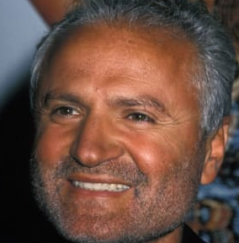
Gianni Versace
Was Born December 2, 1946 in Italy Reggio Di Calabria
His mother was dressmakers and he grew up watching her make dresses in her small boutique in Italy.
Moved to Milan in 1972 Italian ateliers
With the help of Girombellis, an Italian fashion family, Gianni Versace established his own company in; Gianni Versace Spa 1978.

Slide 3


Cont.
Versace became known for his glamorous styles, producing a range of siren dresses that became his trademark.
innovative materials such as aluminum mesh or cutting-edge techniques like "neo-couture" laser technology to fuse leather and rubber.
Head of Medusa was also a recurring image on many of his clothing items and accessories.
Versus and Instante, to his business in the '90s.
Head of Medusa

Slide 4
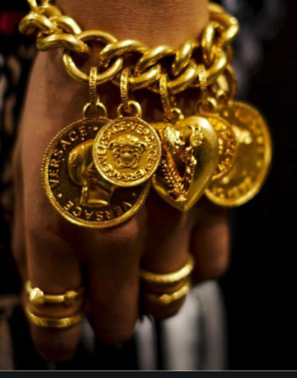
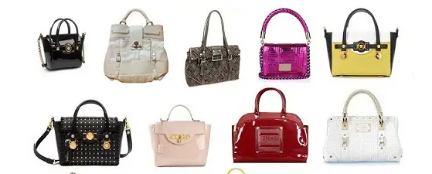
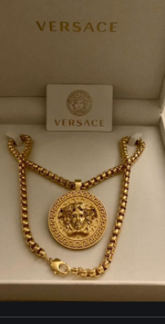
Other products by Versace
Versace offers fashion accessories such as bags, shoes and jewellery

Slide 5
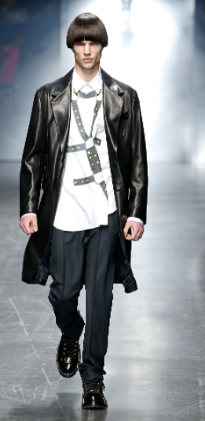
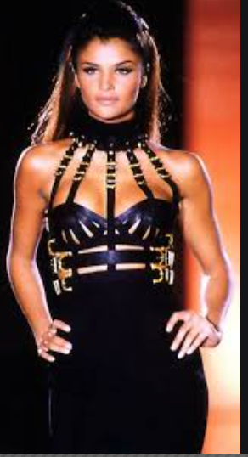
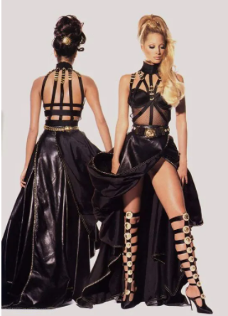
Famous designs
The 90’s bondage collection was one of the worlds lasting marks in design and last till to date.

Slide 6
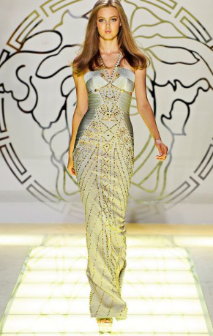
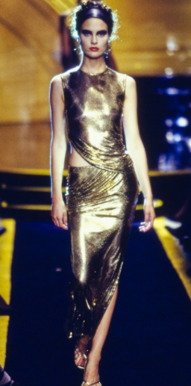
The siren dresses
The siren dresses became a trade mark for Gianni Versace

Slide 7

LOGO
The Versace brand logo is the head of Medusa
Gianni Versace inspiration for the Versace logo came from the artwork on the floor of the ruins in Rome that he and his siblings used to play on.
Gianni fell for Medusa specifically because of the way that she made people fall hopelessly in love with her with no chance of ever going bac.
He hoped that his company would have the same effect on the people who purchased Versace products.

Slide 8
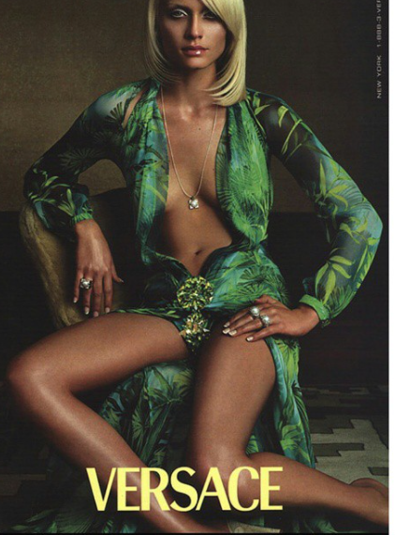
Versace style and illustrations
This aseducyive dress
Versace tops many lists of most iconic dresses for its celebration of the female form.
From the revealing safety-pin gown in 1994 worn by Elizabeth Hurley
Color green
Material stain blend floral.

Slide 9
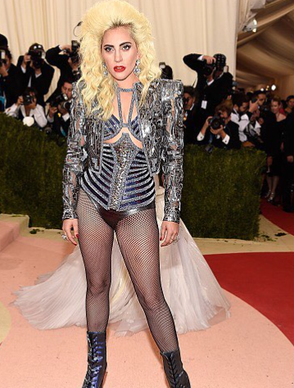
Atelier Versace
Atelier Versace is a haute couture collection.
Black and silver Color Baroque Velvet

Slide 10
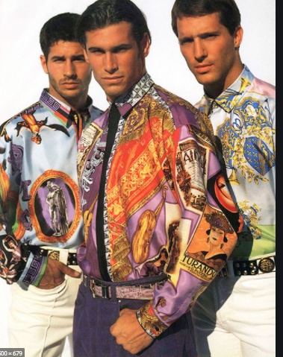
Vintage shirts
Material- silk
Multi-color and floral

Slide 11
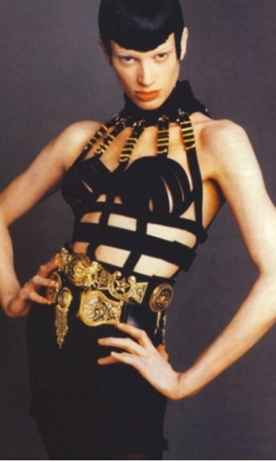
Bondage edition
Black leather, gold backless ad sultry skin-tight gold and leather belts.

Slide 12
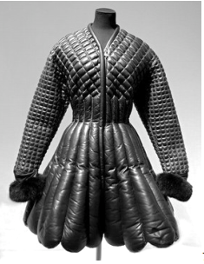
The wild west inspiration
Rain coat rain boat material and inspiration from the west.

Slide 13
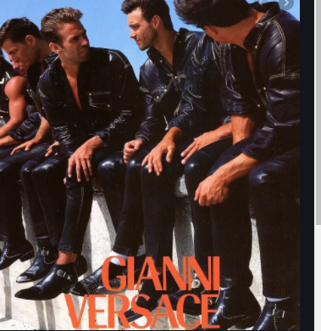
Versace 1993 Men’s Collection,
Color Black
Material- leather soft feel

Slide 14
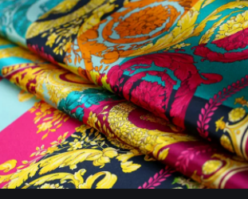
Versace material illustration
This is the Versace silk fabric
Eco friendly

Slide 15
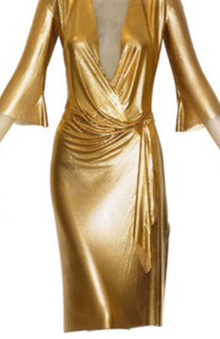
Cont.
Metallic dress
Colour gold

Slide 16
conclusion
Gianni Versace fashion neer fades with the famous bonfaged and 1990 mens collection still on demand and very much appreciated.
Gianni’s style is timeless, sultry, and not tied to fashion bondages but rather by experiences and going beyond the norm to create master piece that not time of class can beat!
The Versace collection and style and material is a bloom out of creativity.

